Slide 1


Edu Consultancy
Group A

Slide 2


INTRODUCTION
The current educational consultancy processes face significant challenges in delivering personalized guidance and ensuring streamlined interactions among key stakeholders, including parents, students, and administrators.
Lack of Centralized Platforms:
Absence of a unified system for effective communication and planning, leading to fragmented interactions.
Limited Tools for Subscription Management:
Inefficient methods for handling subscriptions hinder user experience and operational efficiency.
Insufficient Use of Modern Technologies:
Lack of integration with advanced technologies like AI for content creation and automated notifications.
Manual Dependency on Critical Operations:
Reliance on manual processes for managing user data, payments, and feedback, resulting in errors and inefficiencies.

Slide 3
OBJECTIVE
Streamlines Communication and Collaboration:
Provides a centralized system for effective interaction among students, parents, and administrators.
Enhances Operational Efficiency:
Automates the management of user data, payments, and feedback, minimizing manual dependencies and errors.
Integrates Modern Technologies:
Incorporates AI-driven content generation and automated notifications to improve user engagement and system functionality.
Optimizes Subscription Management:
Facilitates secure and efficient handling of subscriptions with seamless payment integration.
Delivers a User-Centric Experience:
Ensures personalized guidance and easy navigation through intuitive dashboards and interactive features.

Slide 4
KEY FEATURE
Centralized Communication and Management:
Unified platform for seamless interaction between students, parents, and administrators.
Administrators can manage contacts, feedback, products, and blogs, ensuring streamlined communication.
Efficient Subscription Handling:
Razorpay integration for secure and hassle-free subscription management.
User-friendly dashboards to track subscriptions and transactions.
Automated Notifications and Email Services:
OTP-based email verification for password resets.
Automated purchase confirmations and real-time toast notifications for user actions.
AI and Modern Technology Integration (Future Enhancement):
AI-driven tools for content generation, enabling administrators to create blogs and newsletters quickly.
User-Centric Features:
Users can view, edit, and delete their blogs, products, contacts, and feedback.
Comprehensive dashboards for activity and transaction overview.
Secure and Scalable Infrastructure:
Built using React and Spring Boot, ensuring high performance and scalability.
Adherence to security best practices for safeguarding user data and transactions.

Slide 5
TECH STACK
FRONT END
React:
A powerful JavaScript library for building interactive user interfaces, ensuring a dynamic and responsive user experience.
Tailwind CSS:
A utility-first CSS framework for designing modern, responsive layouts with minimal effort.
BACK END
Spring Boot:
A Java-based framework for building scalable, high-performance backend services. It enables rapid development of robust RESTful APIs and handles the logic for managing user data, payments, and feedback.
DATABASE
MySQL/PostgreSQL:
Relational database management systems for storing and querying data related to users, products, subscriptions, feedback, and more.

Slide 6


IMPLEMENTATION

Slide 7
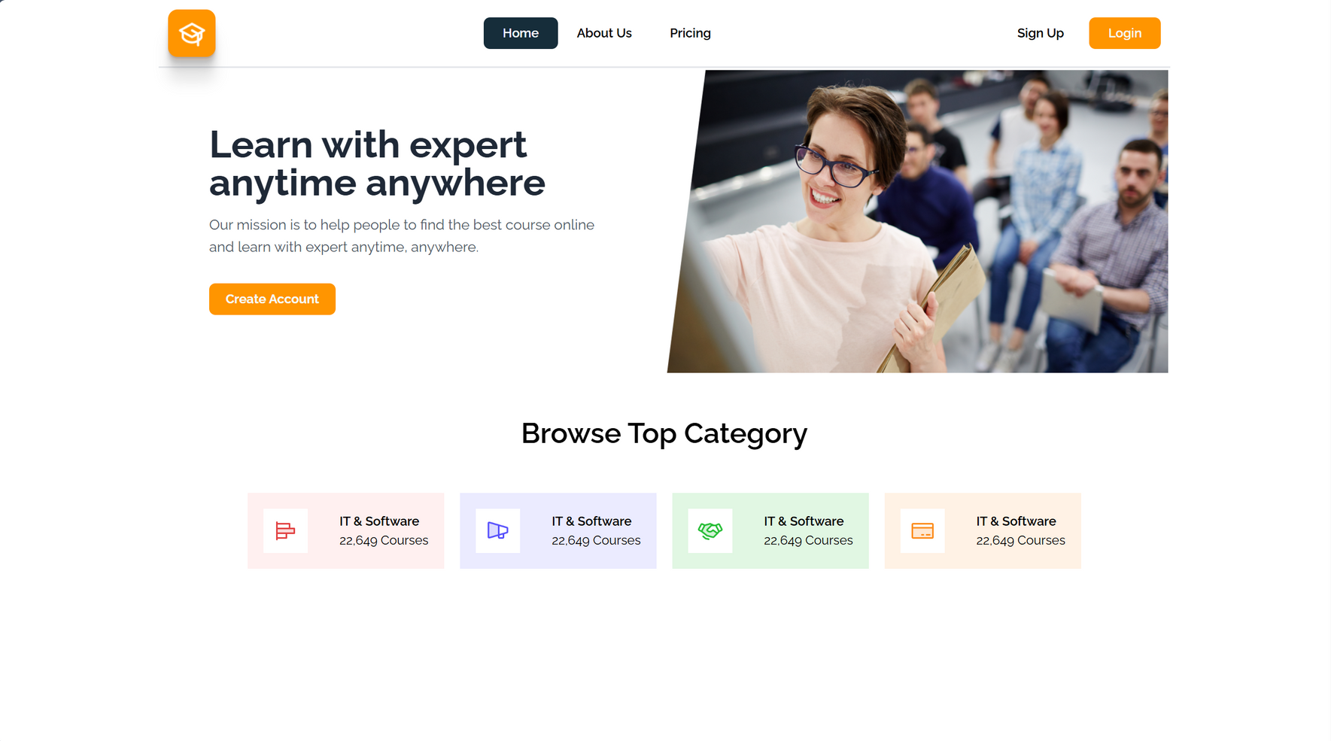

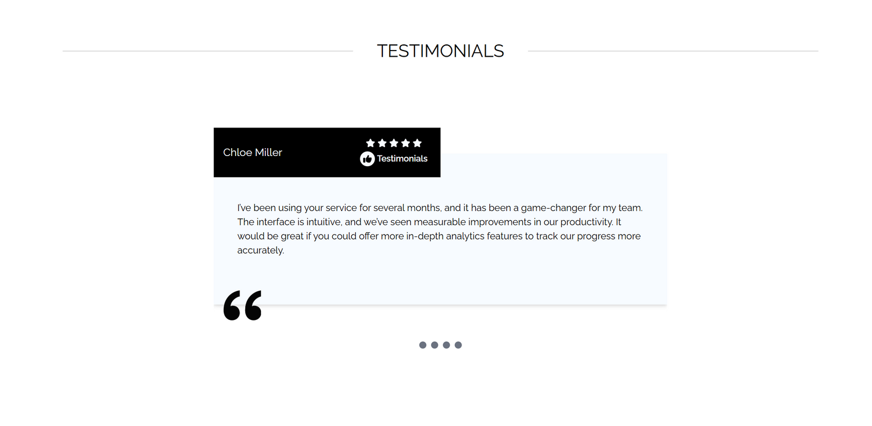
LANDING PAGE

Slide 8

LOGIN AND REGISTRATION

Slide 9

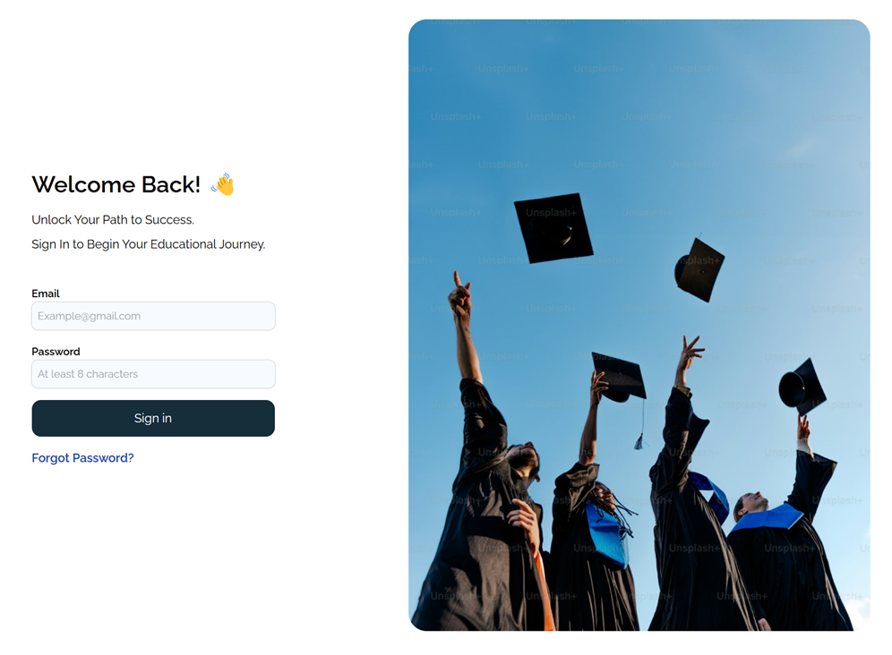
SIGNUP & LOGIN

Slide 10

FORGOT PASSWORD

Slide 11

OTP VERIFICATION

Slide 12

NEW PASSWORD SETUP

Slide 13
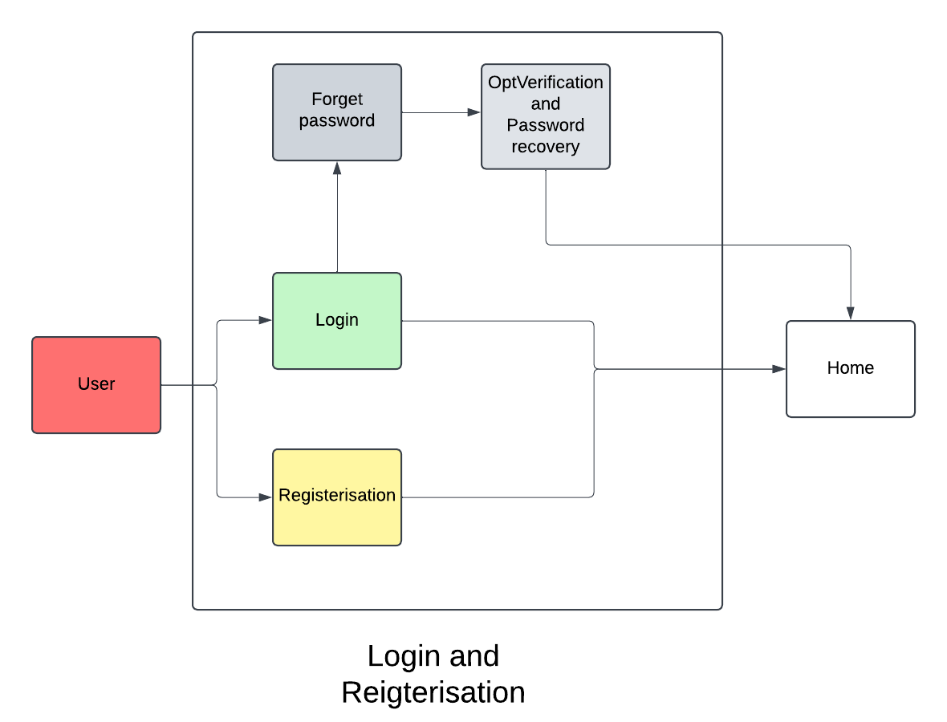
FLOW CHART

Slide 14

USER
DASHBOARD

Slide 15
HOME PAGE AND CONTENTS

Slide 16

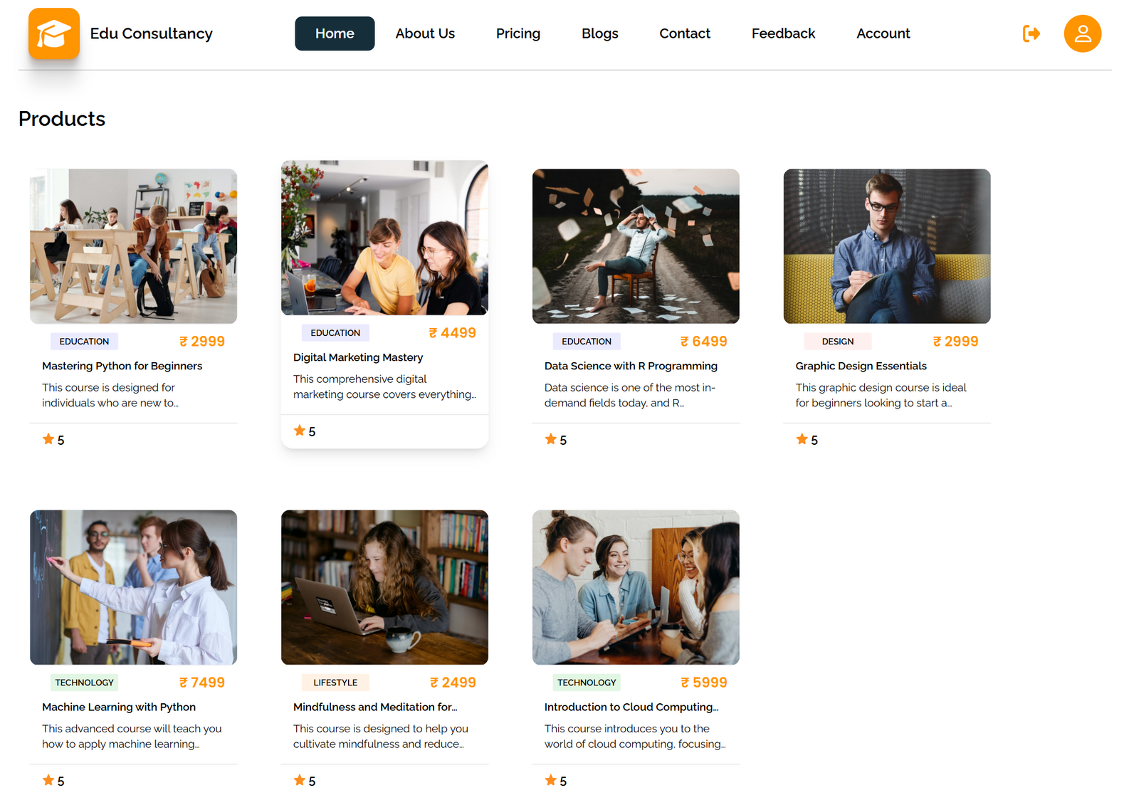
HOME PAGE

Slide 17
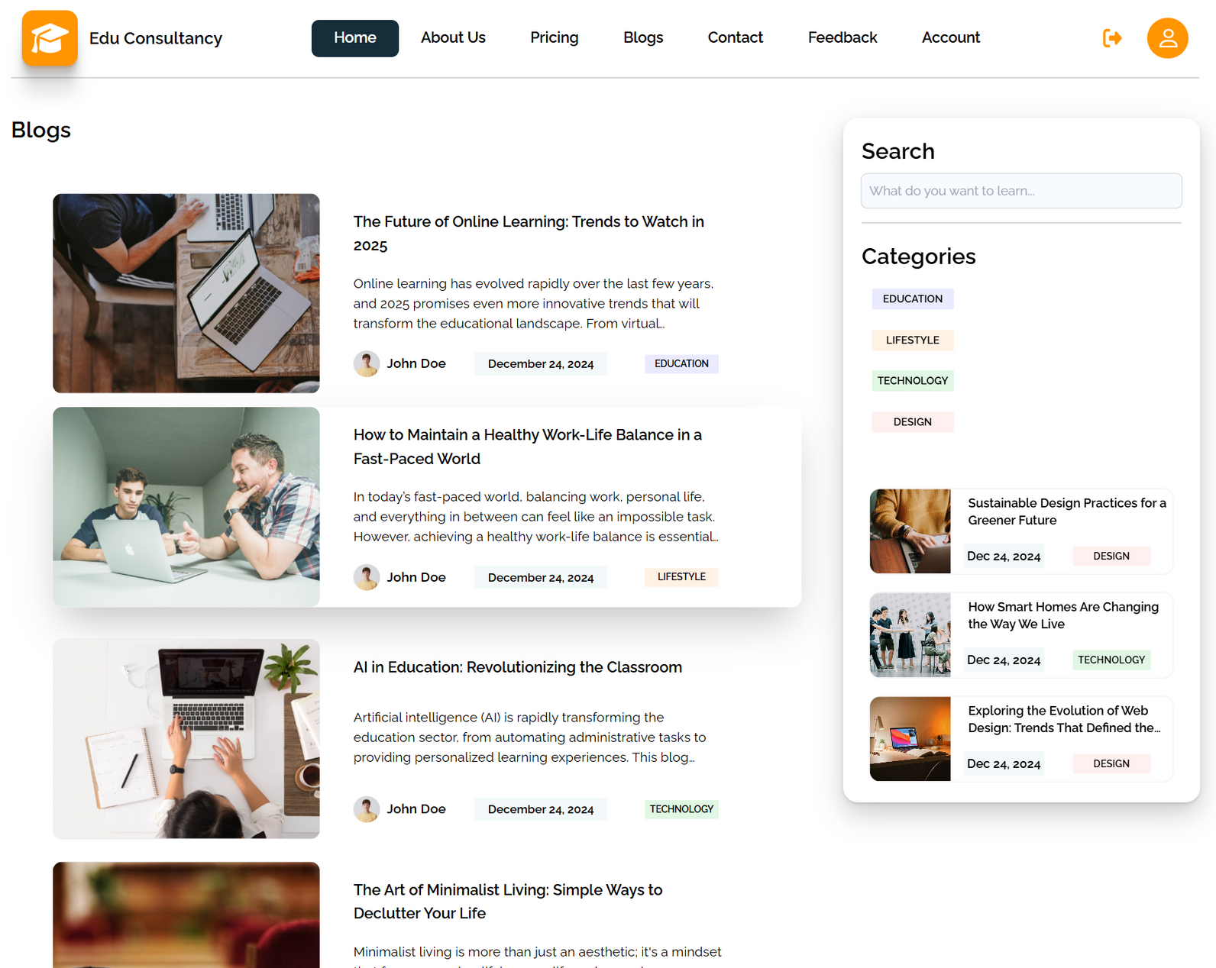
BLOG PAGE

Slide 18
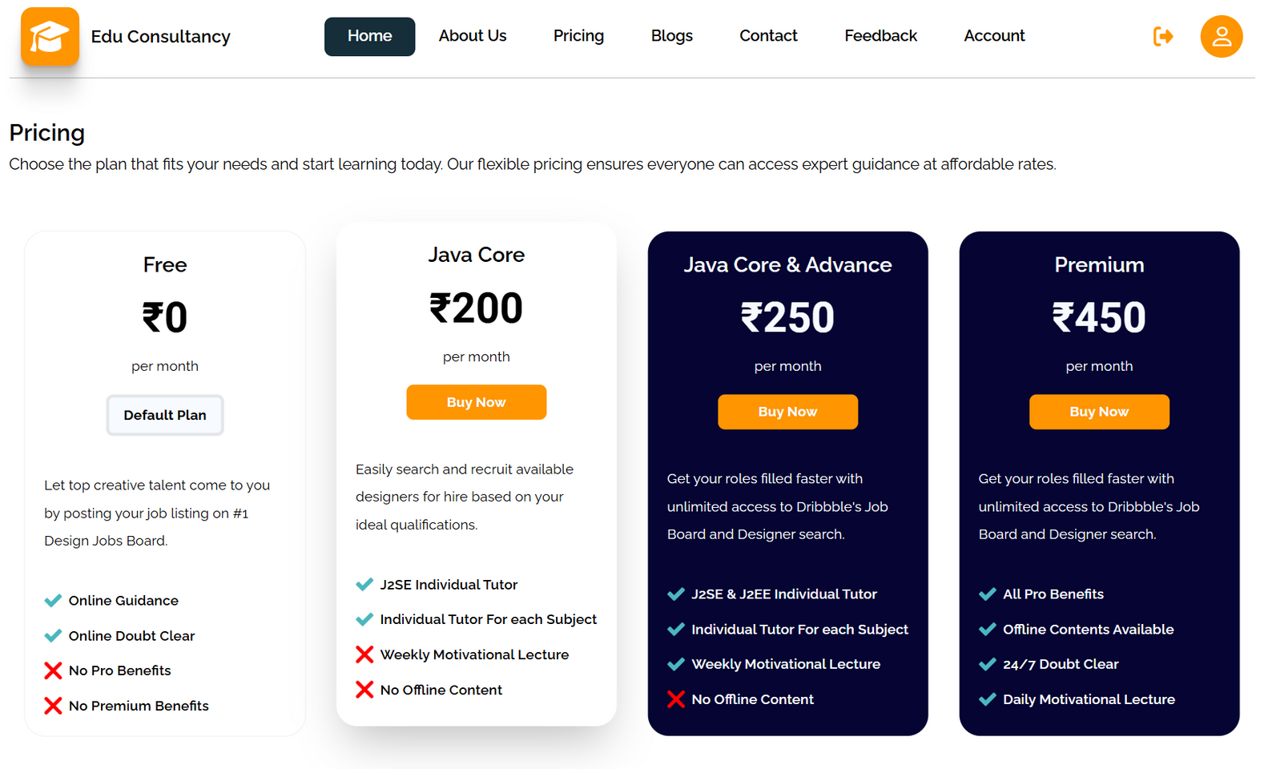
SUBSCRIPTION

Slide 19
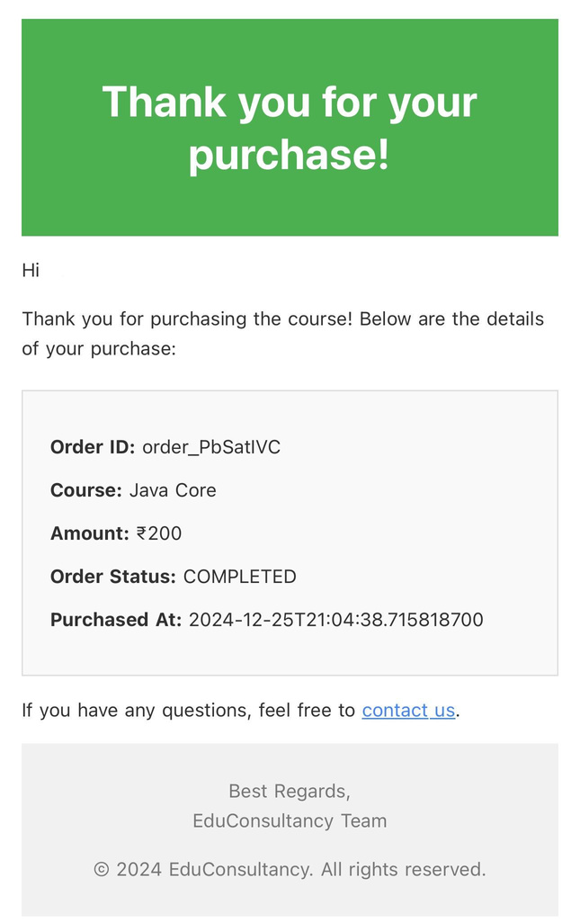
PAYMENT NOTIFICATION

Slide 20
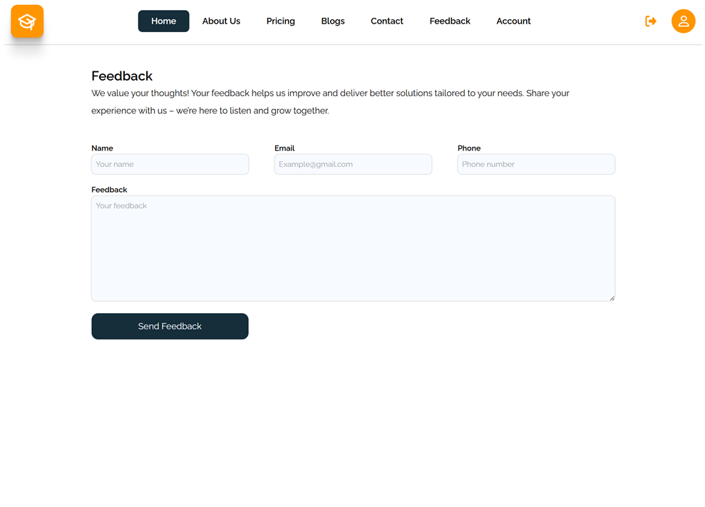
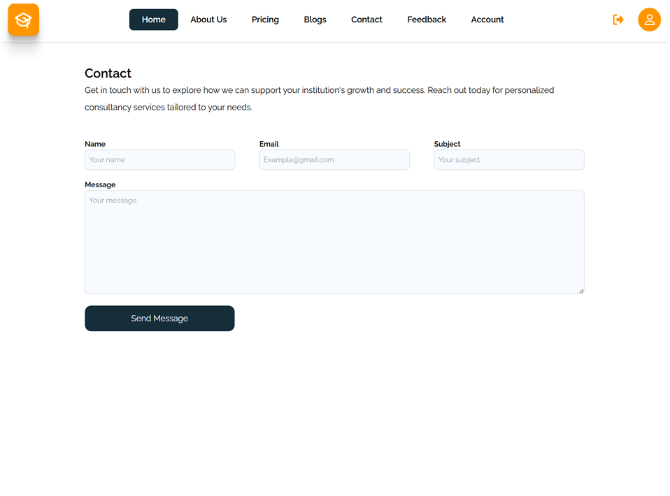
FEEDBACK & CONTACTS

Slide 21
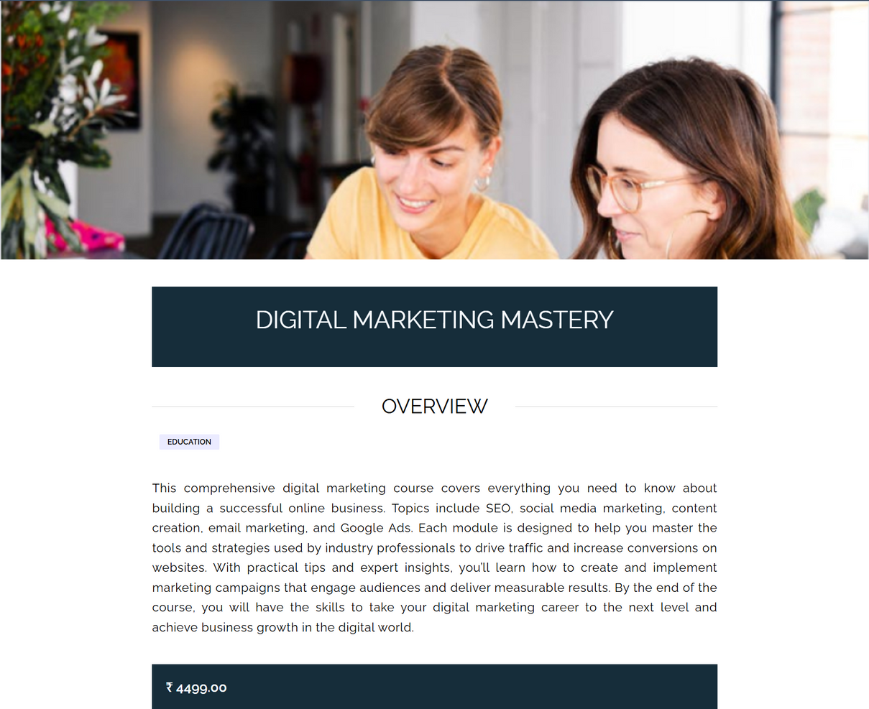
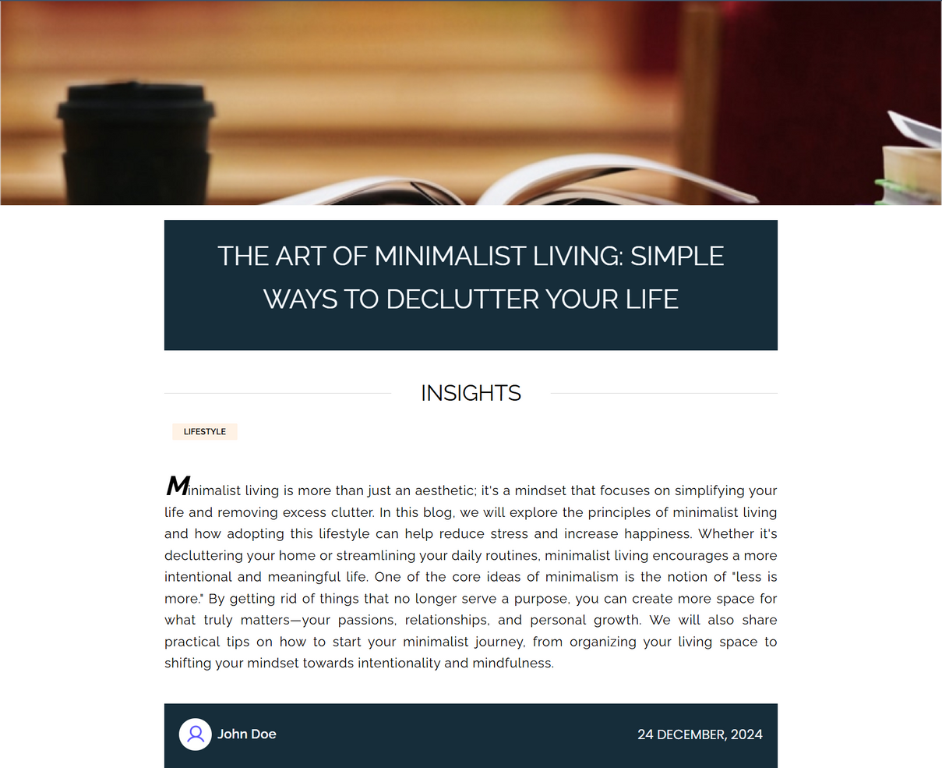
PRODUCT & BLOG

Slide 22
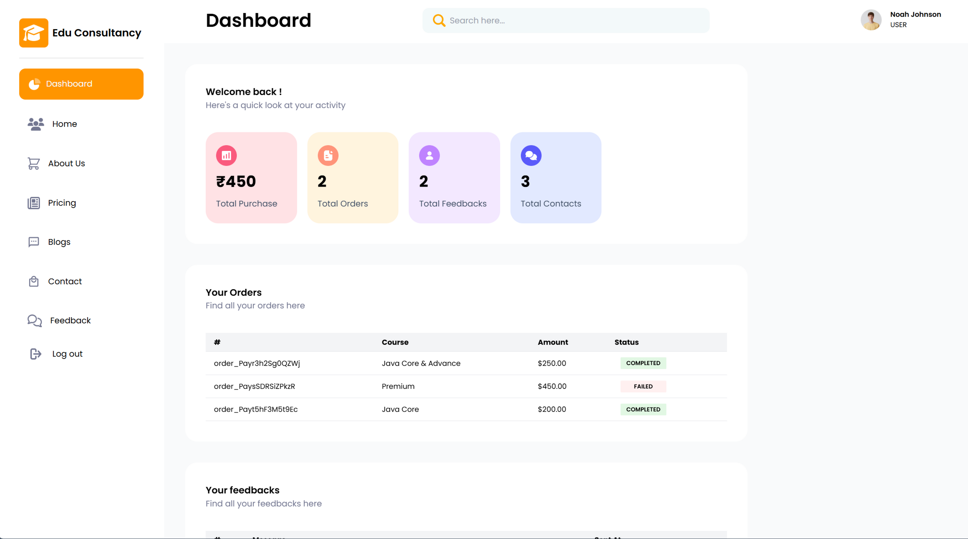
USER DASHBOARD

Slide 23
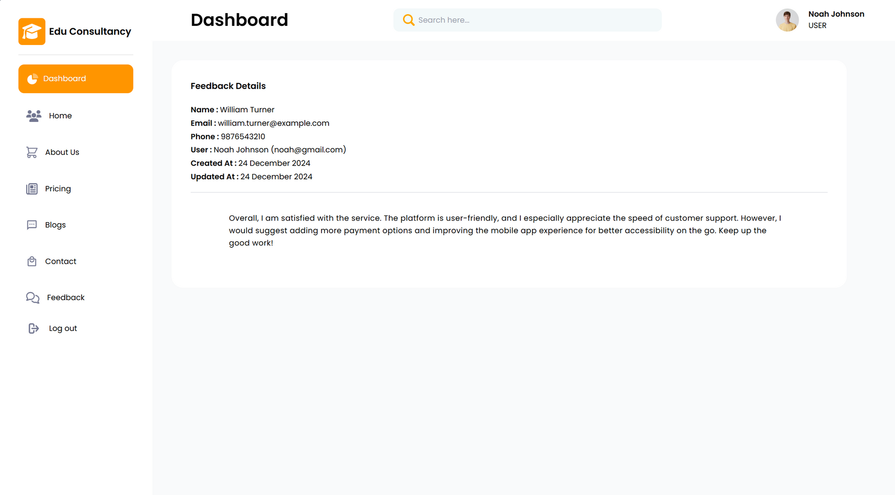
USER DASHBOARD

Slide 24
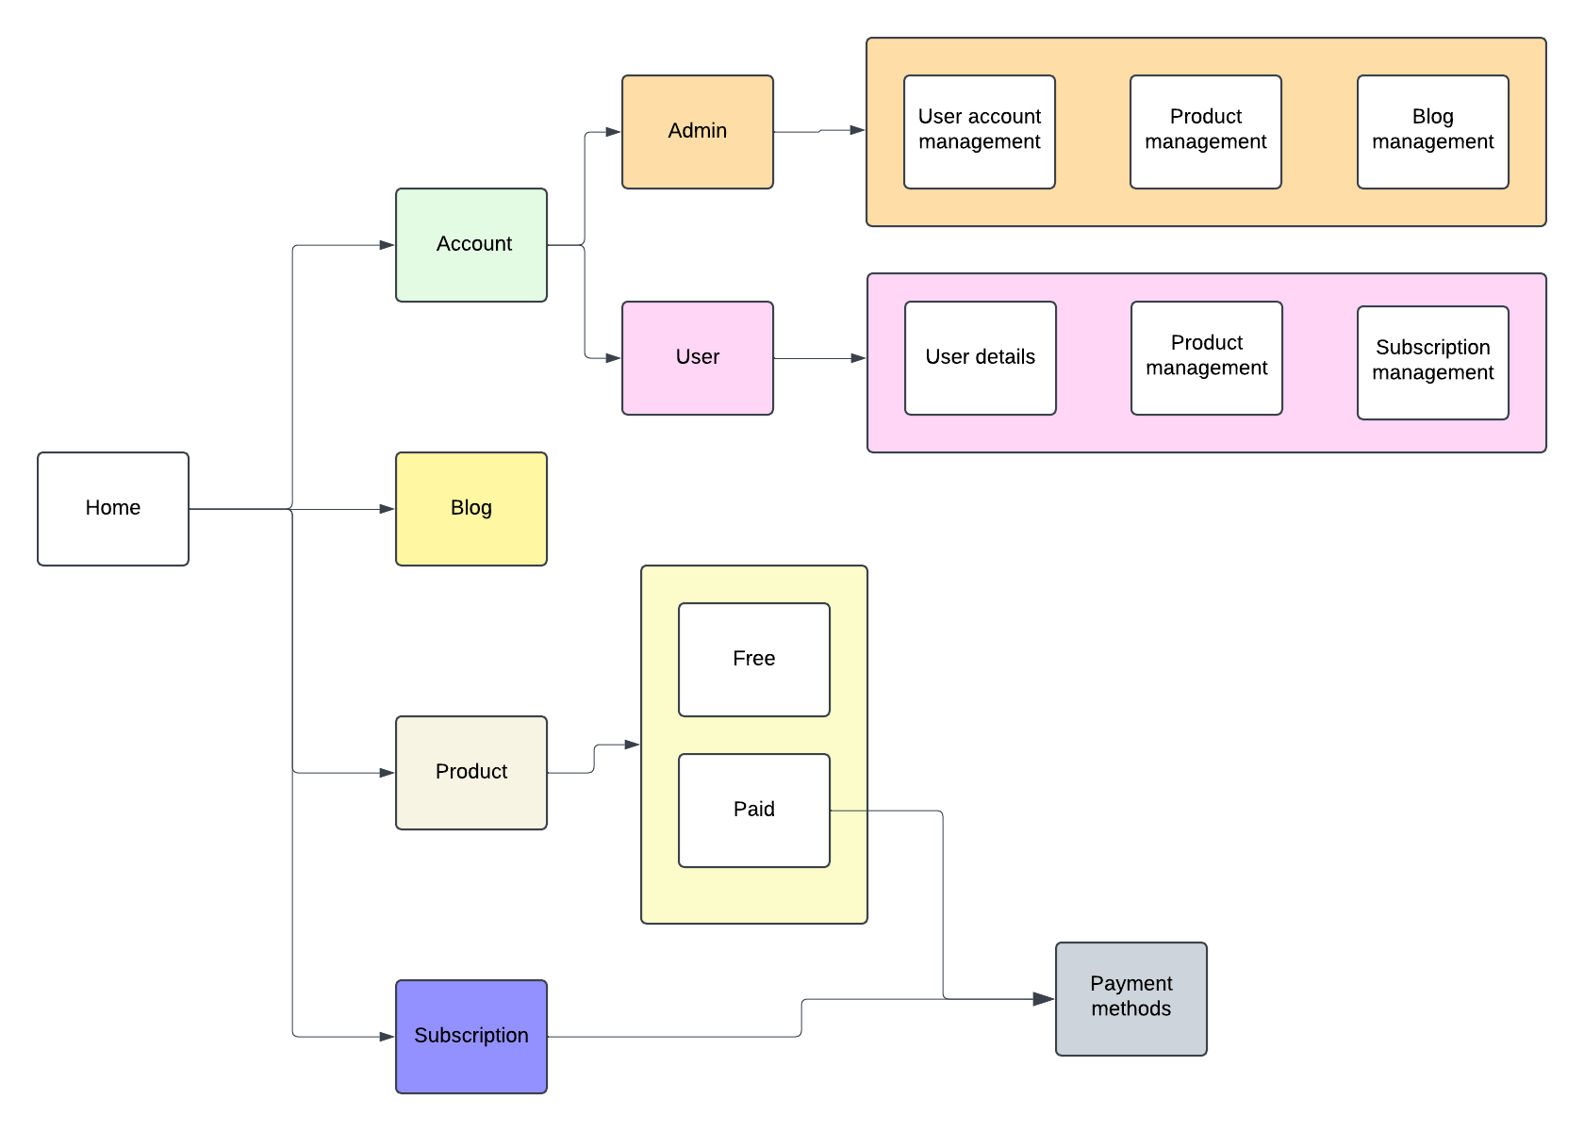
FLOW CHART

Slide 25
ADMIN
DASHBOARD

Slide 26
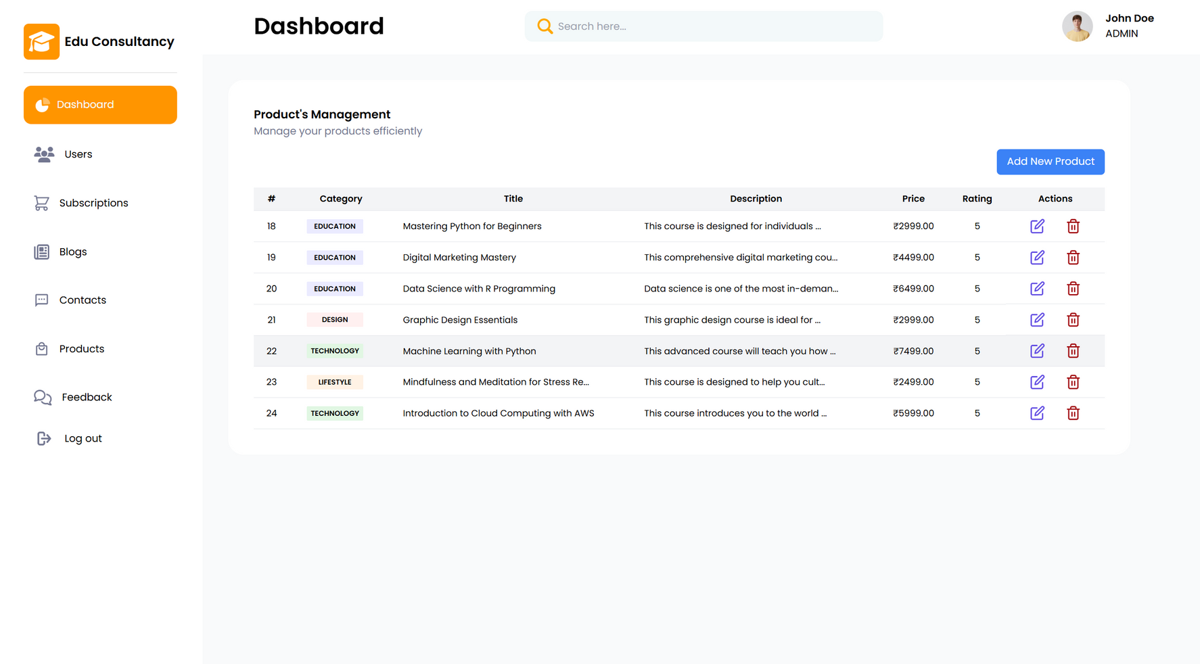
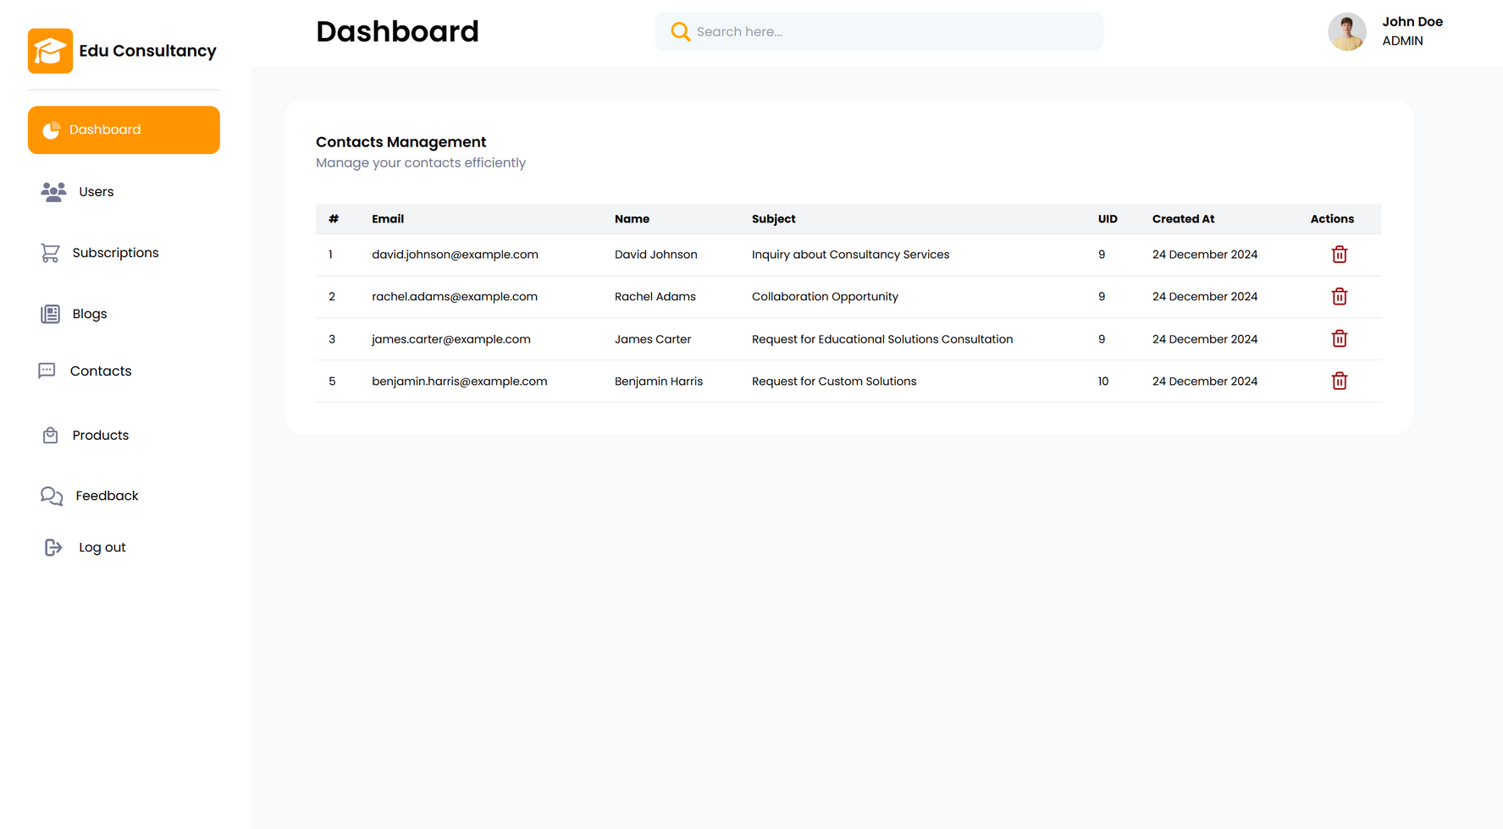
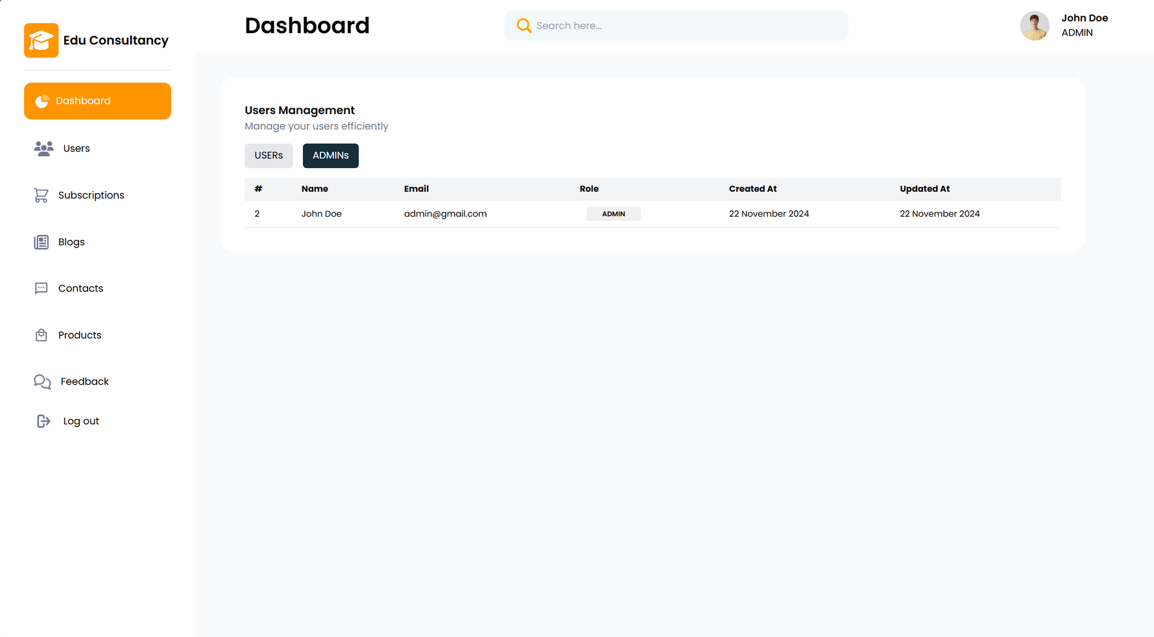
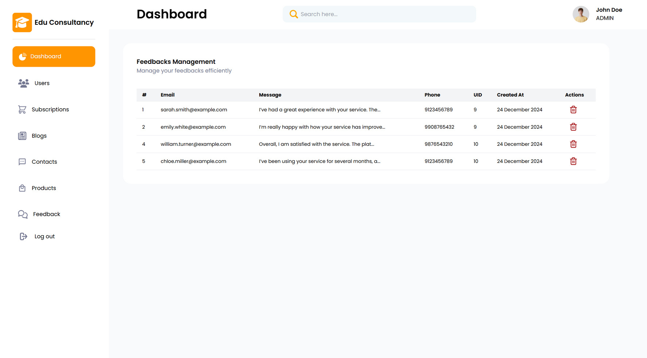
USERS MANAGEMENT

Slide 27
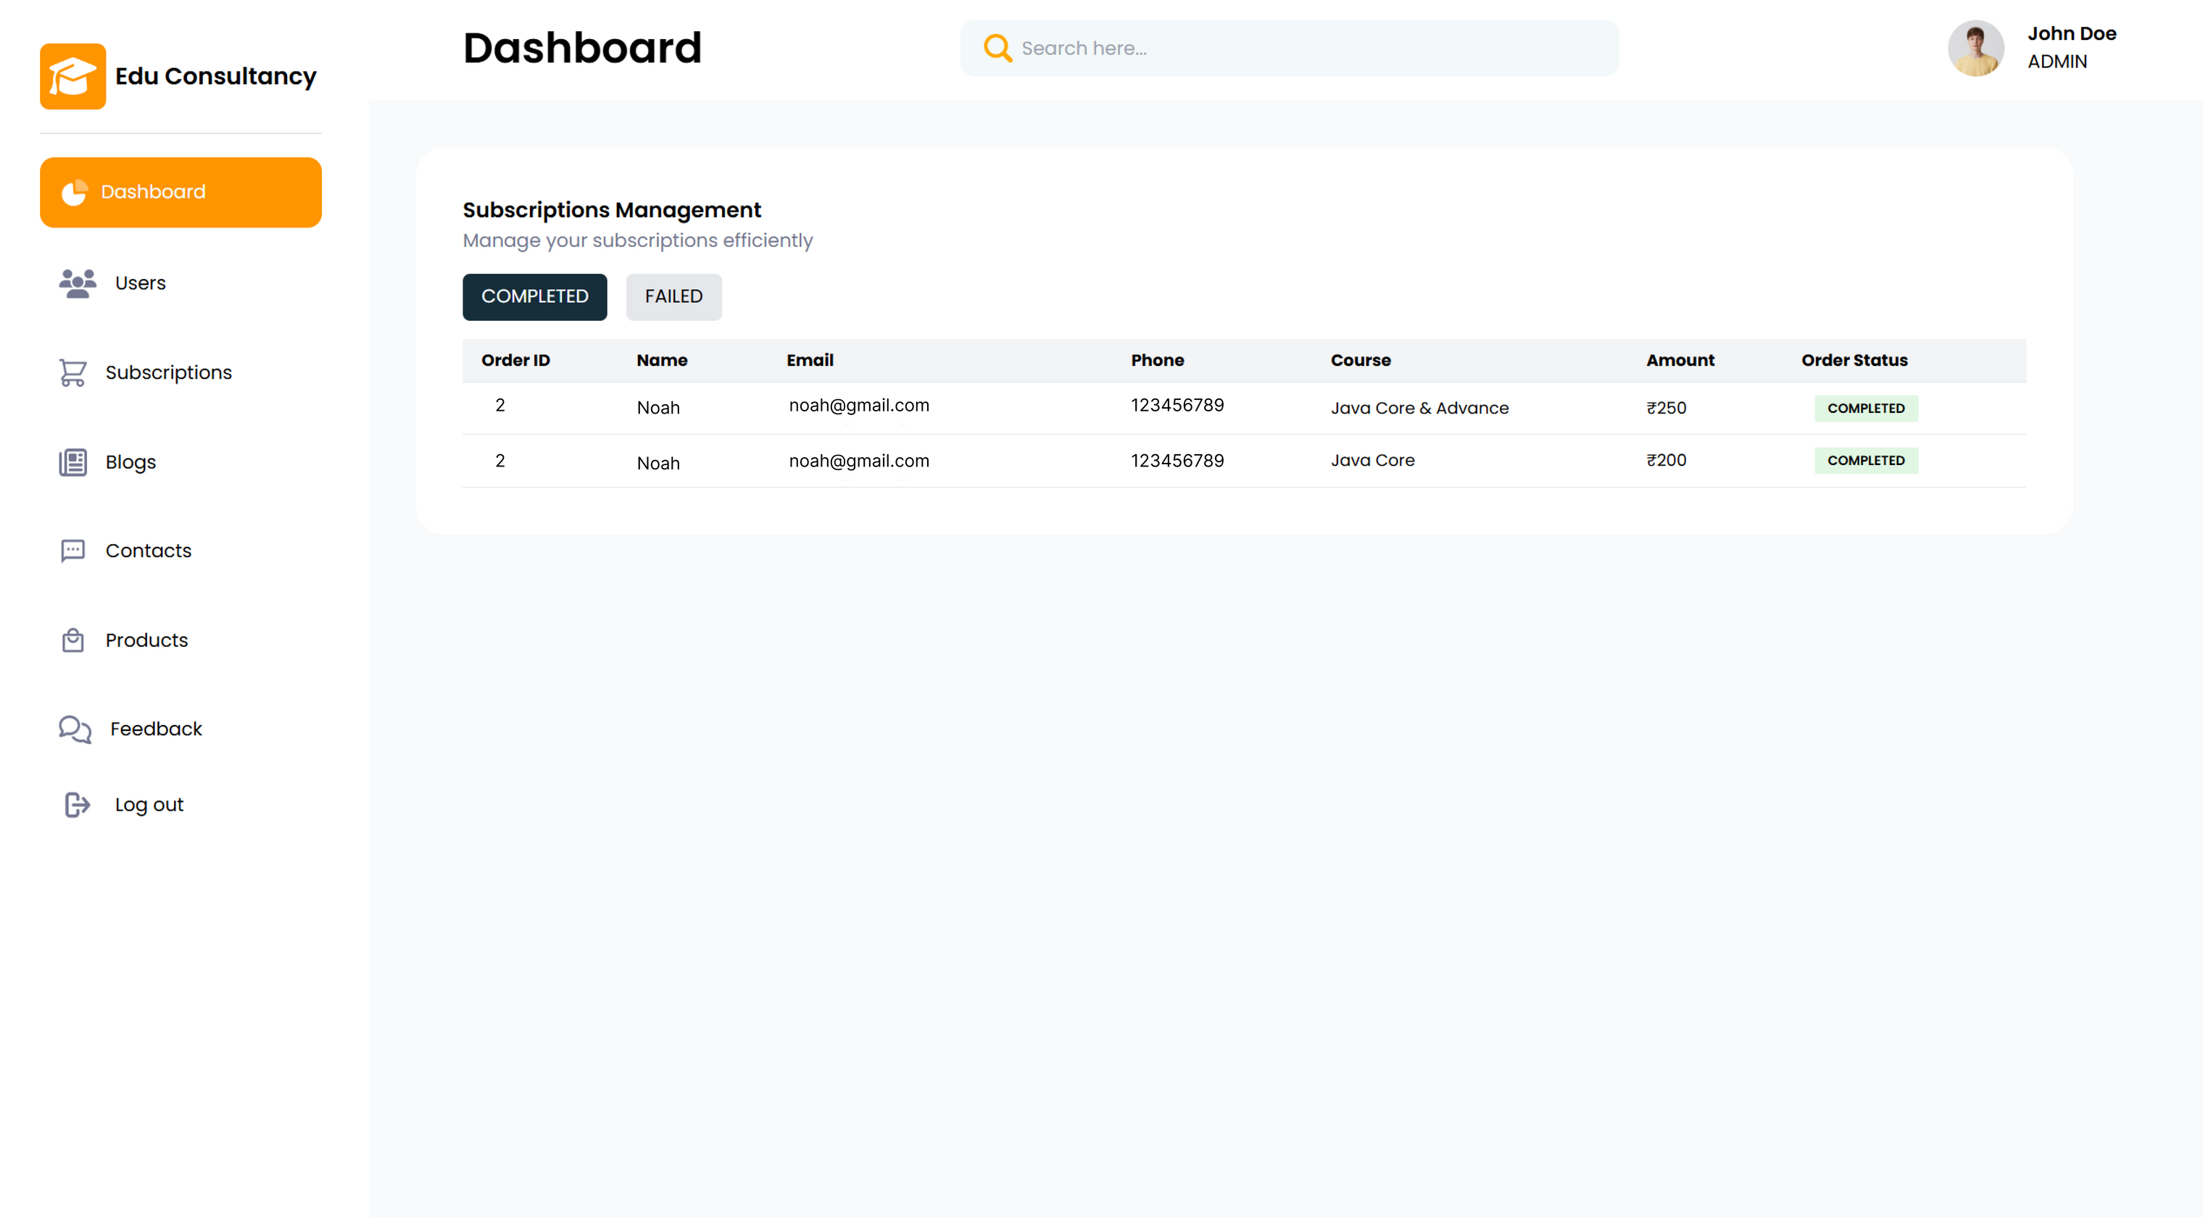
SUBSCRIPTIONS MANAGEMENT

Slide 28
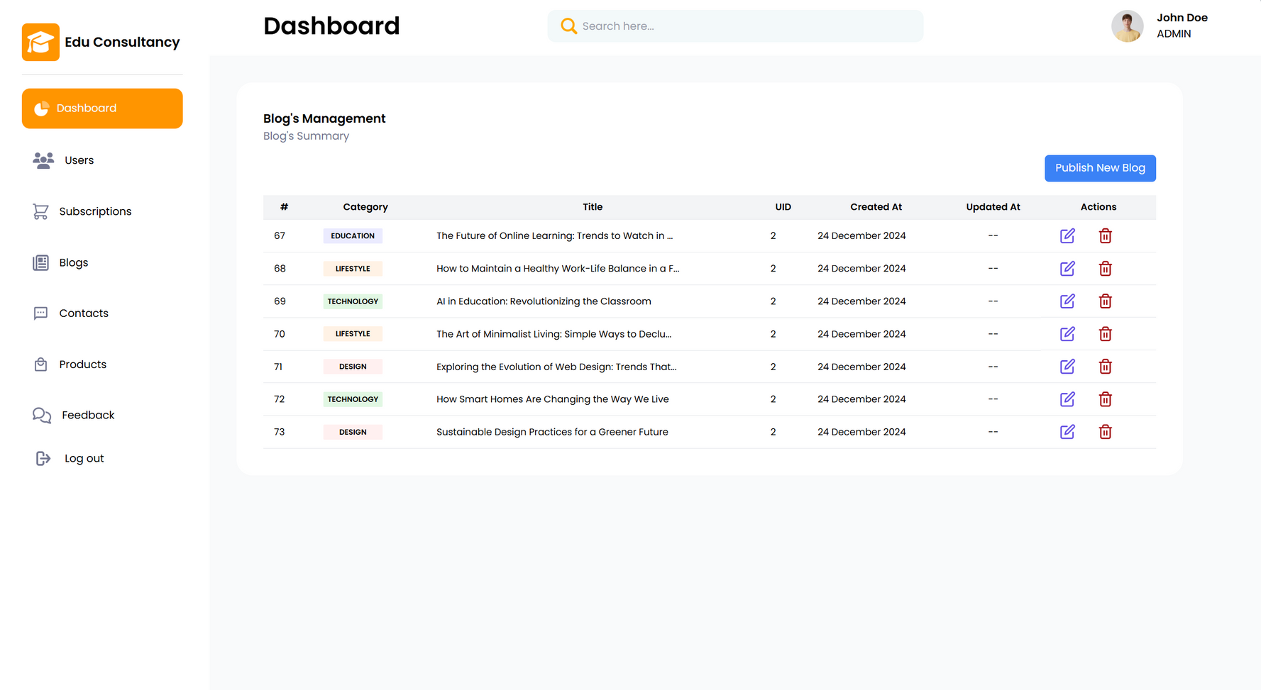
BLOG MANAGEMENT

Slide 29
CONTACT MANAGEMENT

Slide 30
PRODUCT MANAGEMENT

Slide 31
FEEDBACK MANAGEMENT

Slide 32
FUTURE WORKS
AI-Driven Personalization
Implement advanced machine learning algorithms for personalized educational recommendations based on user preferences and performance.
Mobile Application Development
Develop a dedicated mobile app for Android and iOS platforms for enhanced accessibility and user engagement.
Expansion of Educational Offerings
Collaborate with institutions to include a wider range of courses, certifications, and training programs.
Blockchain Integration
Securely manage and verify educational credentials, certifications, and payment transactions using blockchain technology.

Slide 33
THANK YOU!

